Slide 1
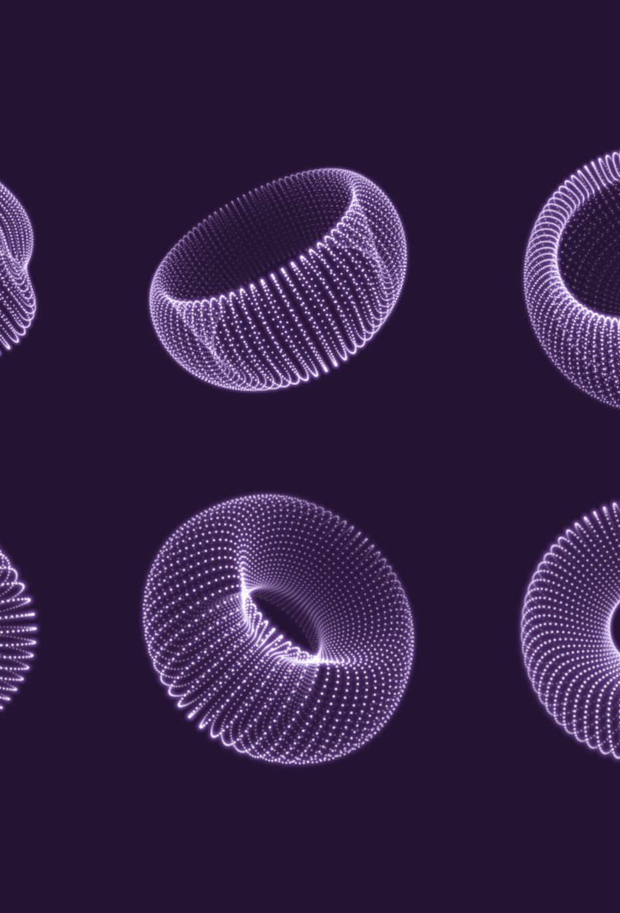
How to Create Presentation using AI

Slide 2
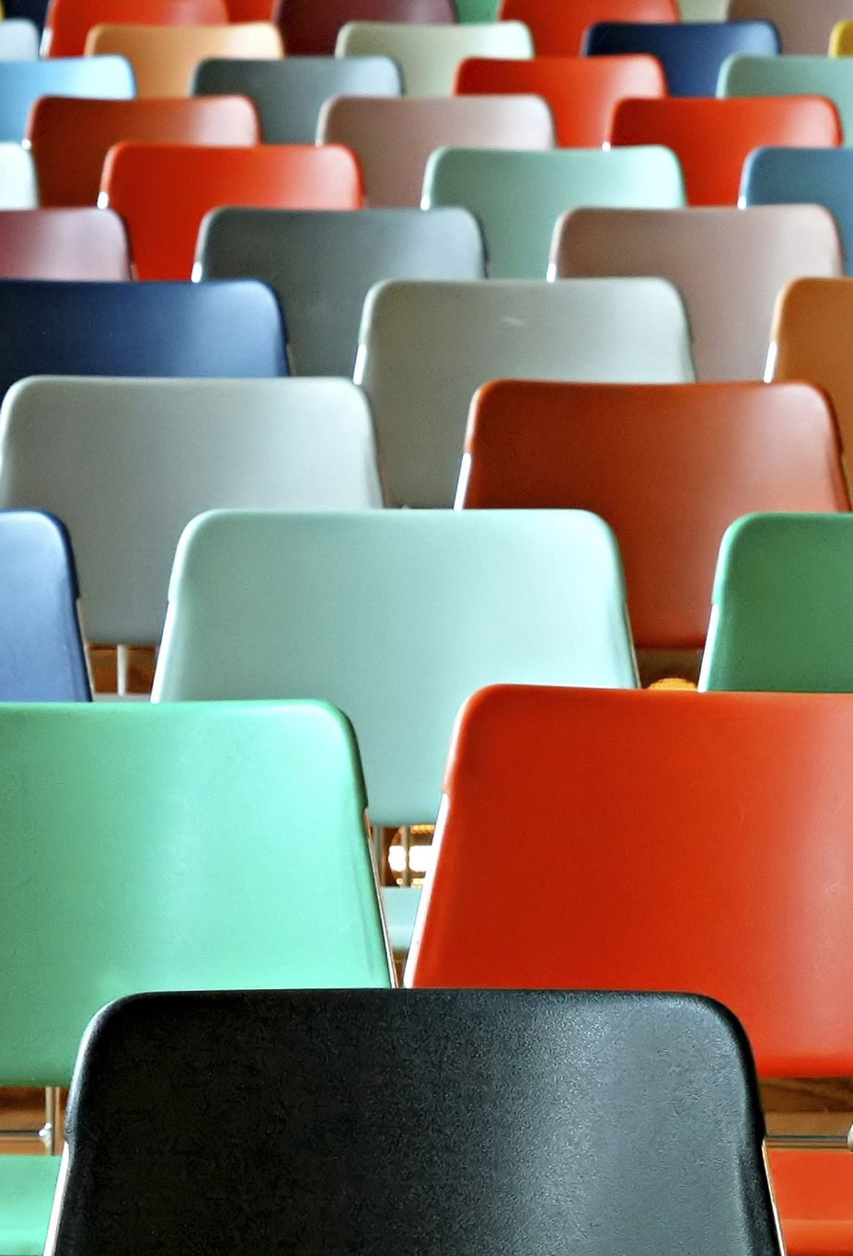
Enhancing PowerPoint Presentations with AI tools
Creating visually appealing slides with AI
Enhancing audience engagement with AI
Ai-powered features in PowerPoint
Benefits of using AI tools for PowerPoint presentation

Slide 3

Optimizing Presentations with AI
Designer uses AI to suggest layouts and images to create stunning slides Presenter Coach uses AI to provide feedback on your delivery, pronunciation and pacing

Slide 4
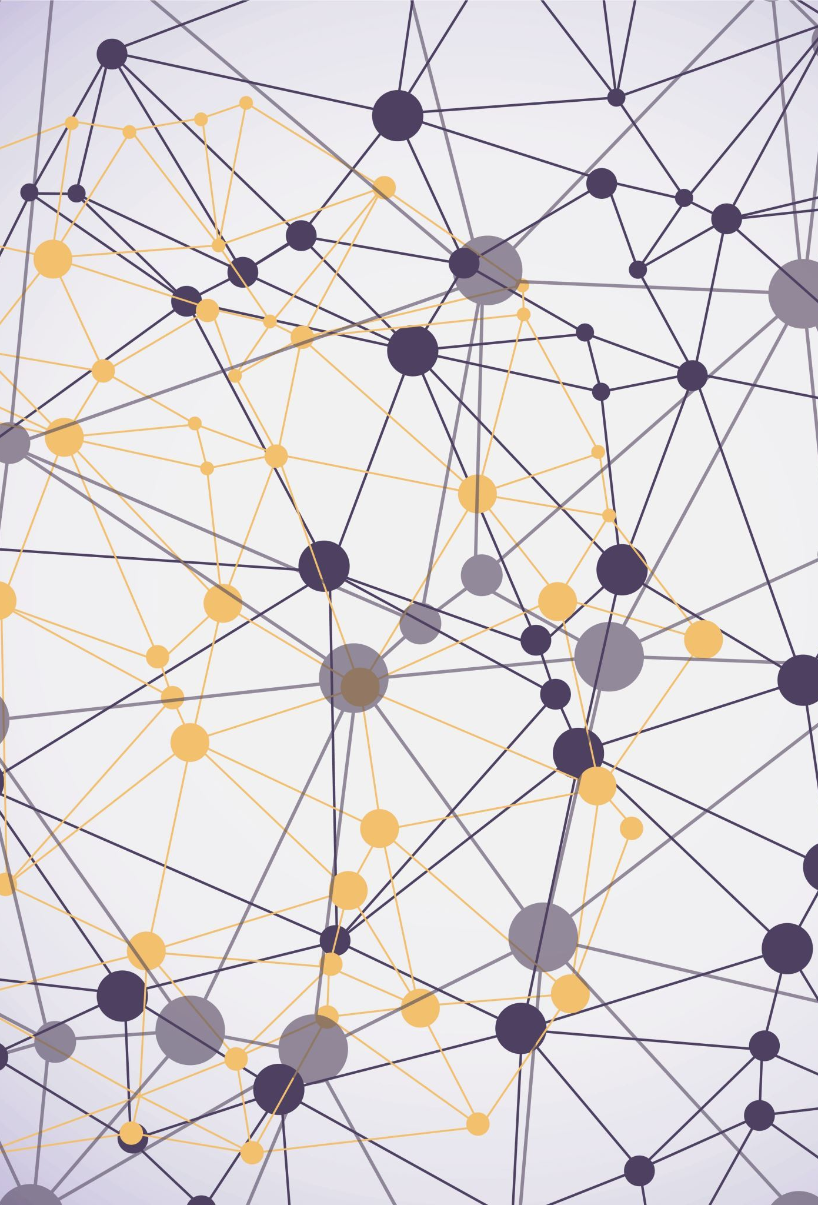
Using AI to maximize visual appeal of your slides

Slide 5

Creating Creative Graphics and Charts with AI-powered tools

Slide 6
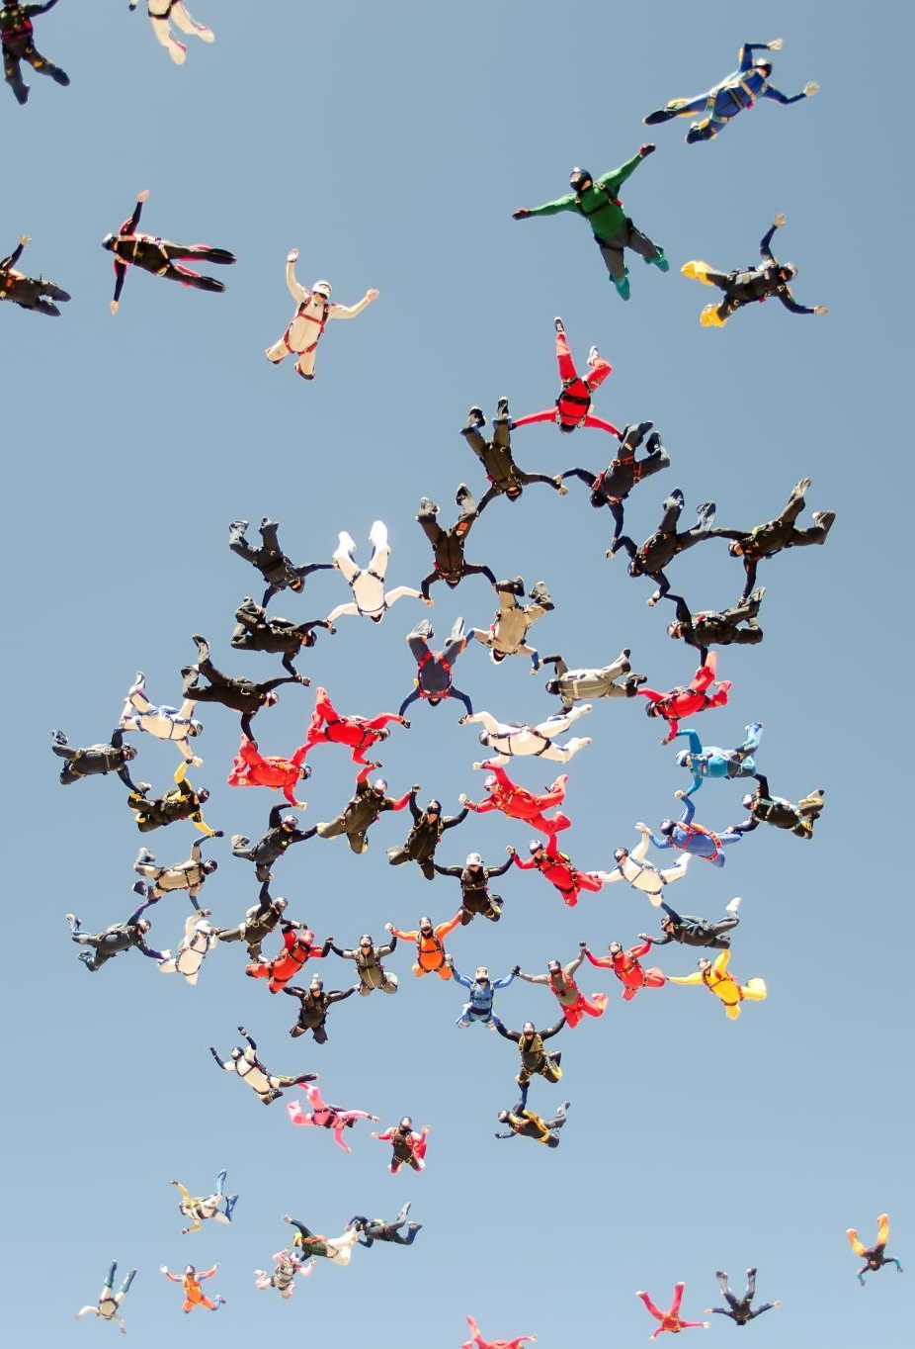
Using AI to enhance audience engagement
Unlock the benefits of AI: Enhance your PowerPoint now!
Closing: With the power of AI at your fingertips, you can create visually stunning and engaging PowerPoint presentations that captivate your audience
So why not give it a try and take your presentations to the next level?

